Slide 1
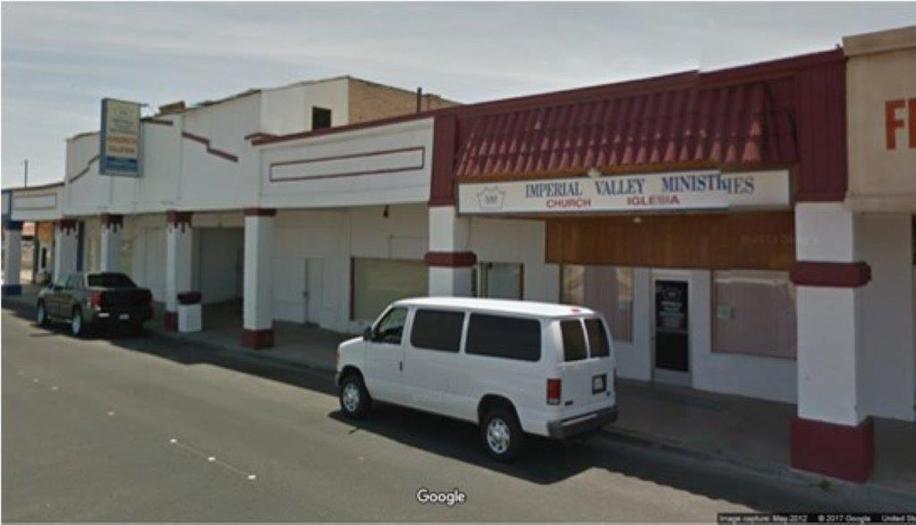
Imperial Valley Ministries (IVM)
427 Broadway, El Centro, CA

Slide 2
Sign-in Sheet

Slide 3
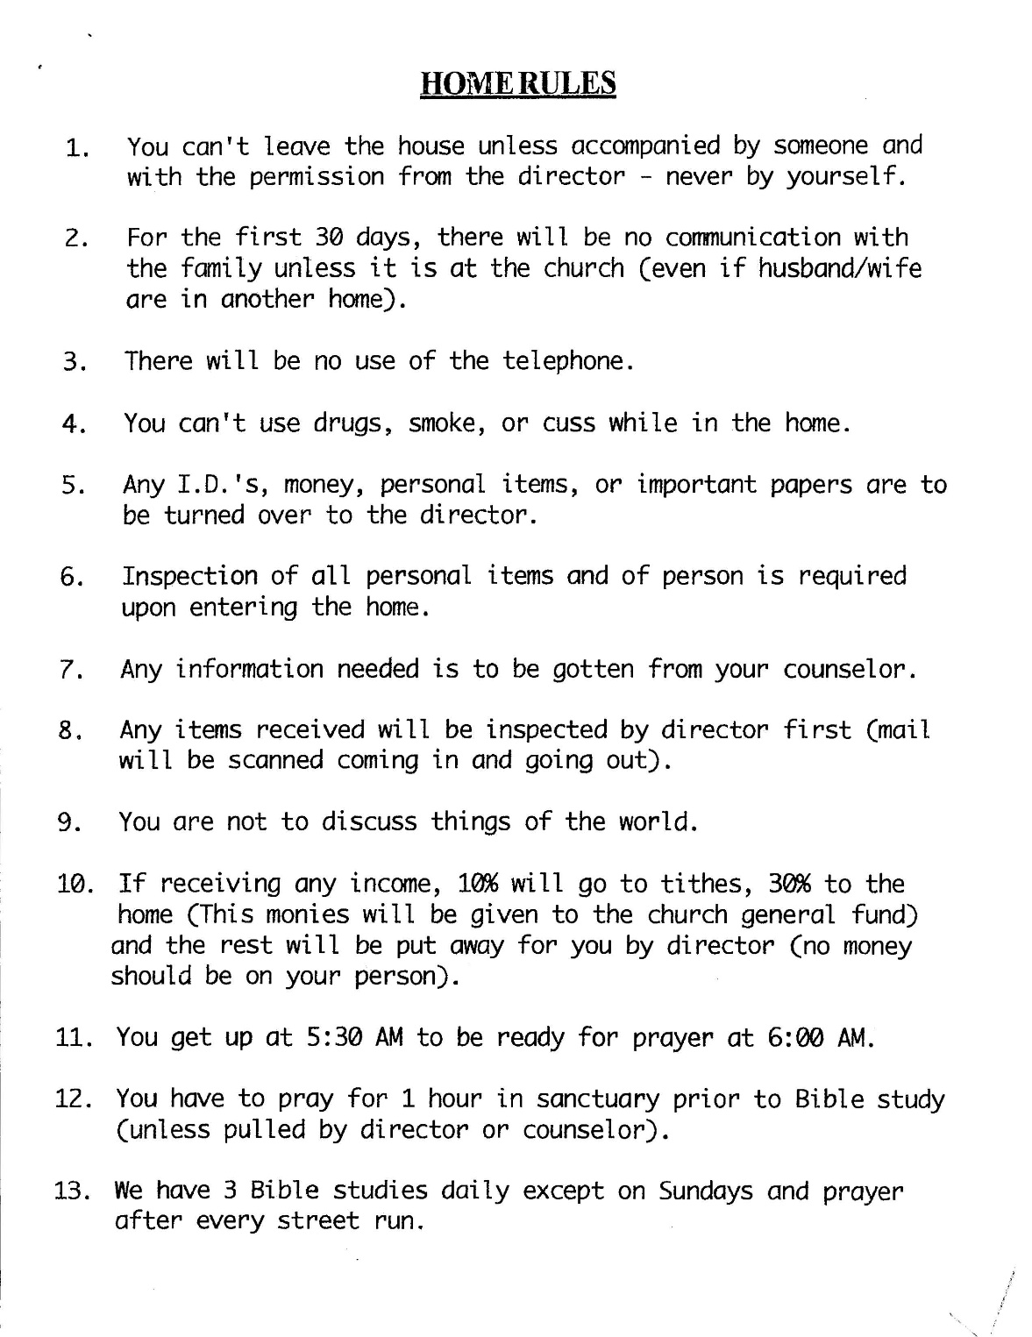
Sign-in Sheet Rules

Slide 4
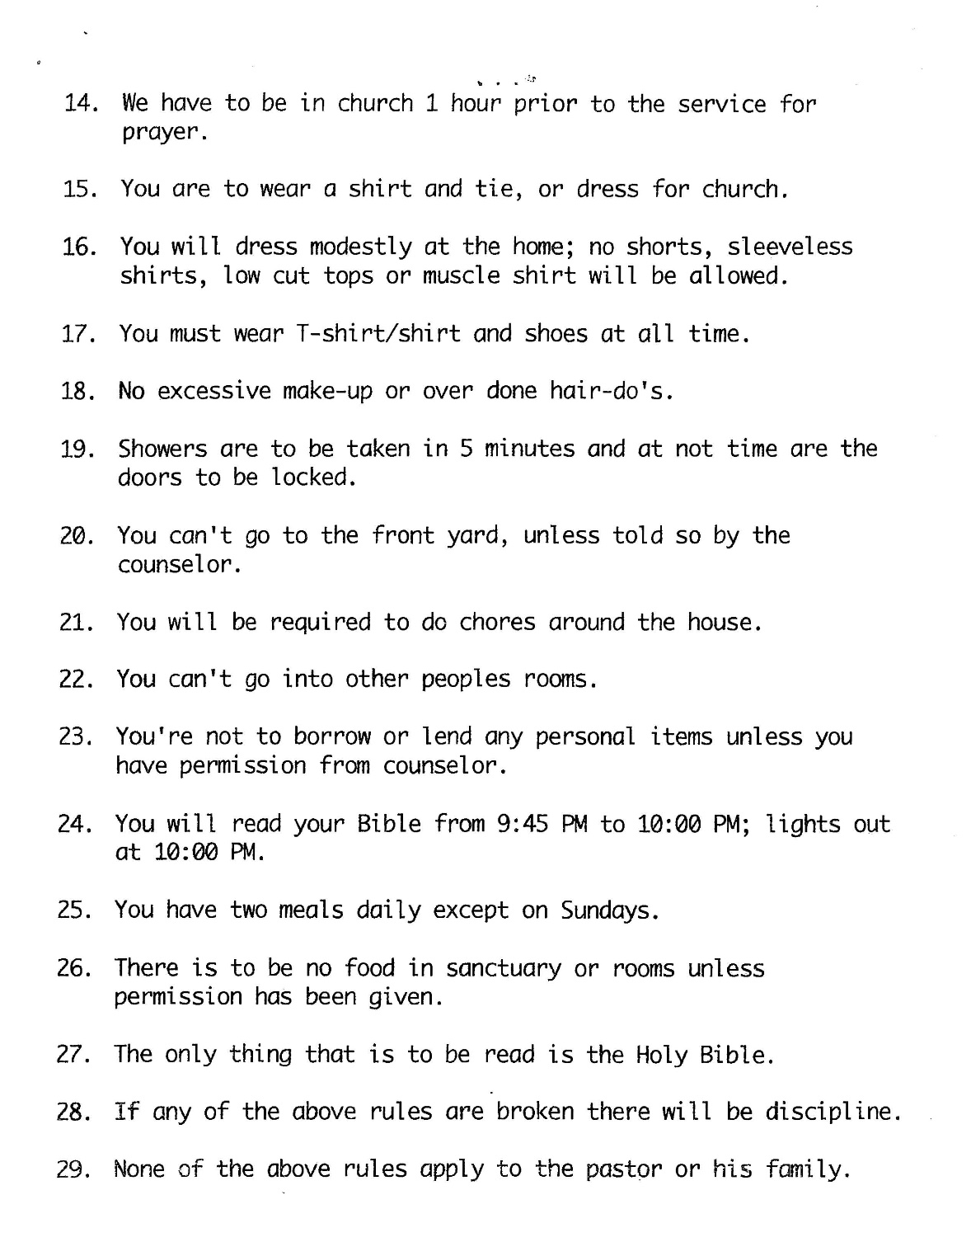
Sign-in Sheet Rules

Slide 5
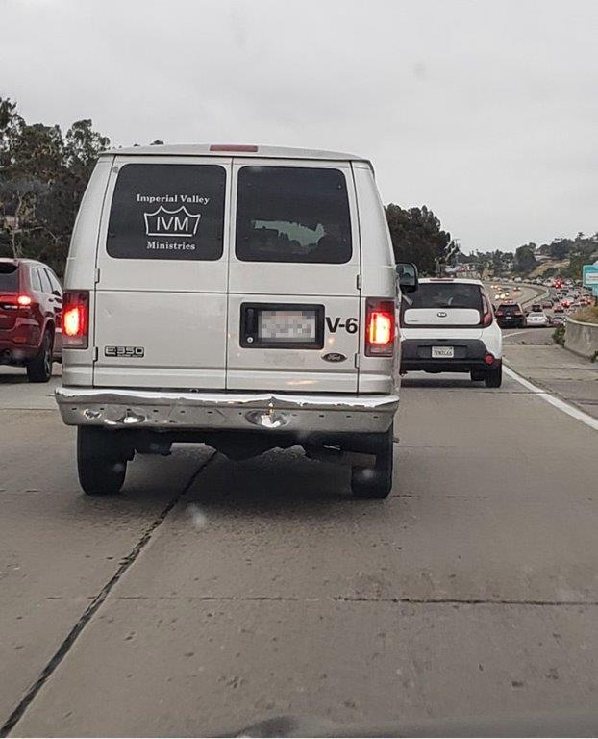
IVM Van

Slide 6
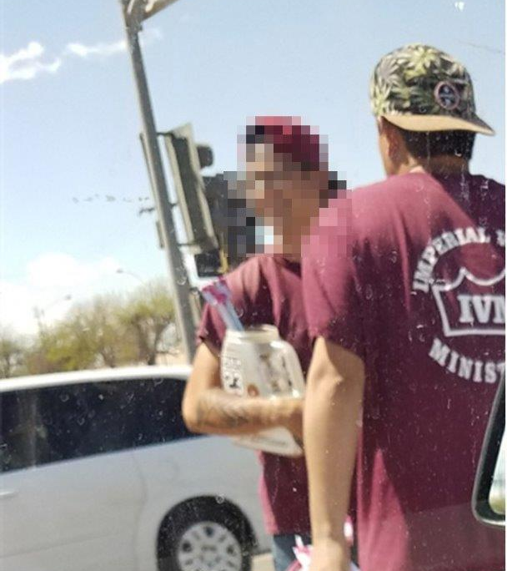
Panhandling

Slide 7
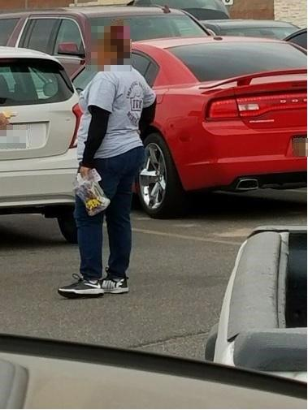
Panhandling

Slide 8
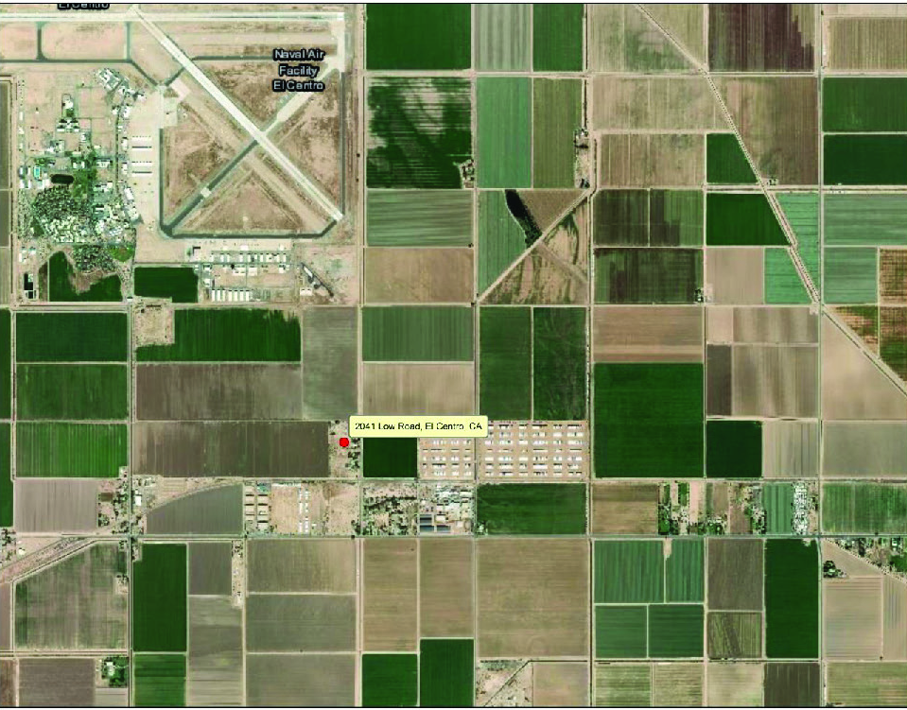
Men’s Ranch

Slide 9
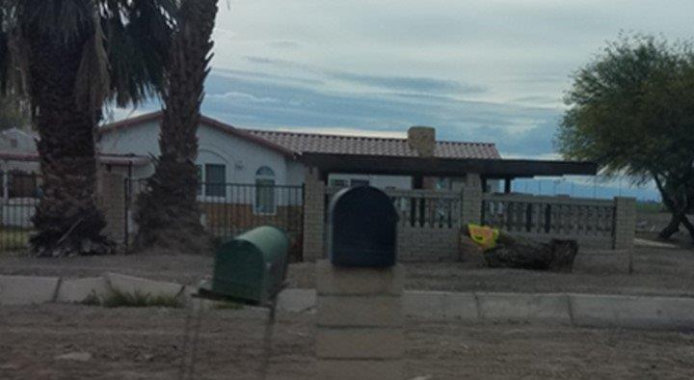
Men’s Ranch
2041 Low Road, El Centro, CA

Slide 10
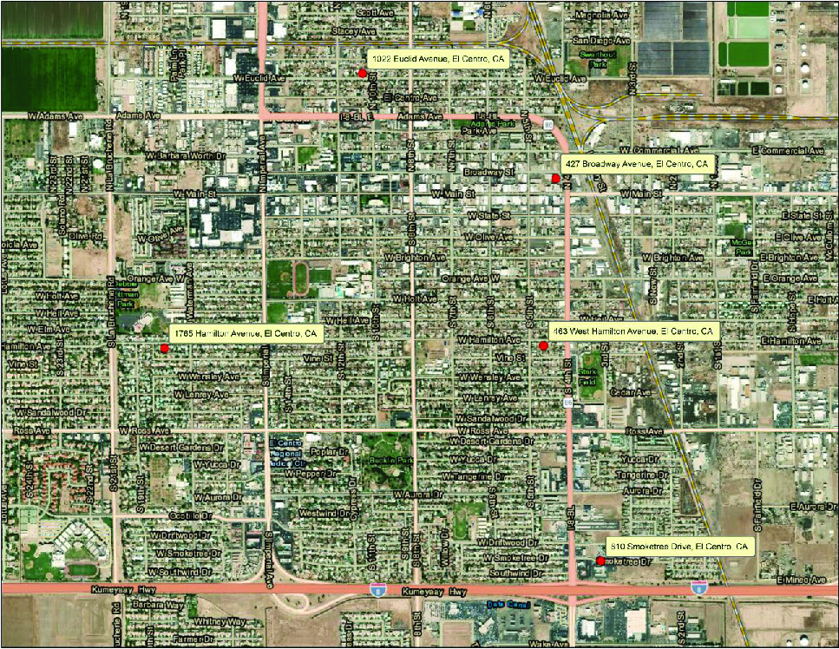
El Centro Locations

Slide 11
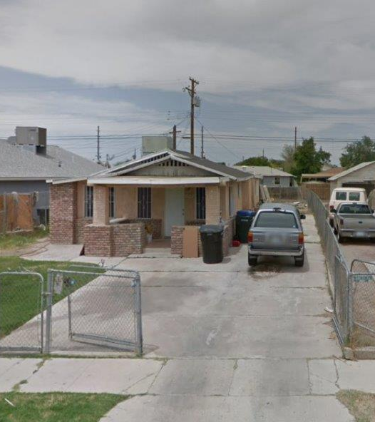
Euclid Location
1022 Euclid Avenue,
El Centro, CA

Slide 12
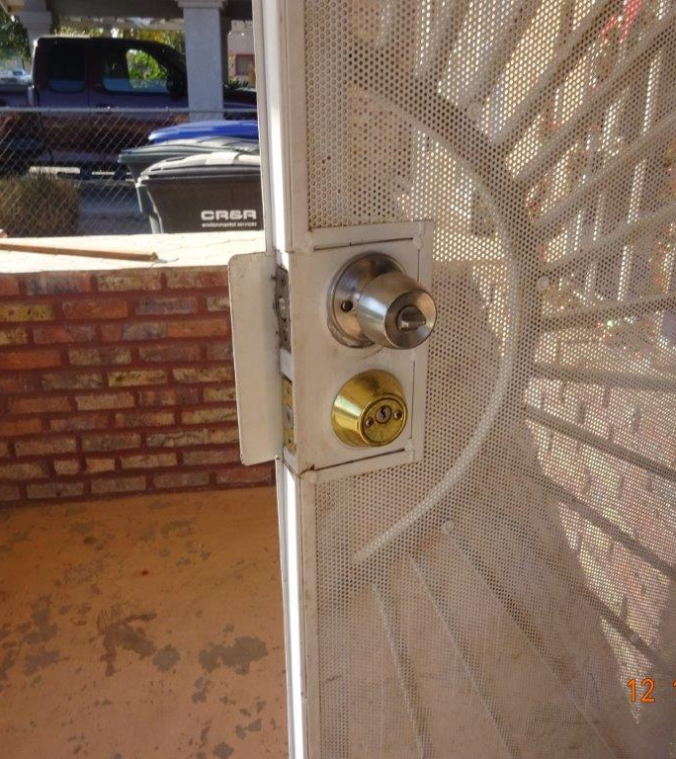
Locks at Euclid Location

Slide 13
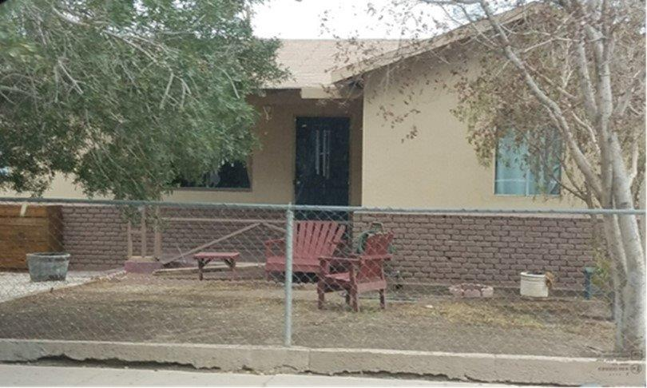
Hamilton Location
463 West Hamilton Avenue, El Centro, CA

Slide 14
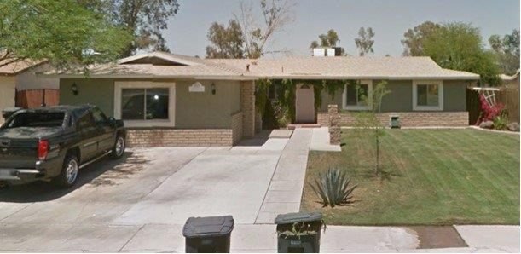
Smoketree Location
810 Smoketree Drive, El Centro, CA

Slide 15
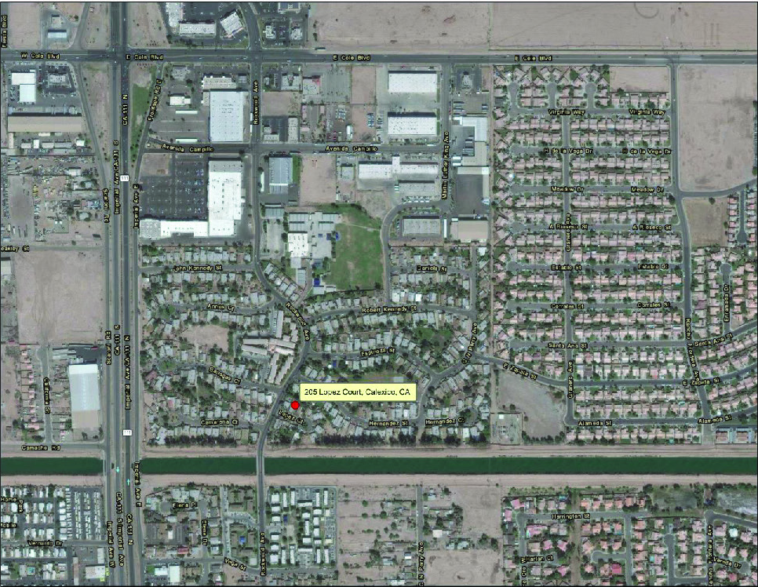
Calexico

Slide 16
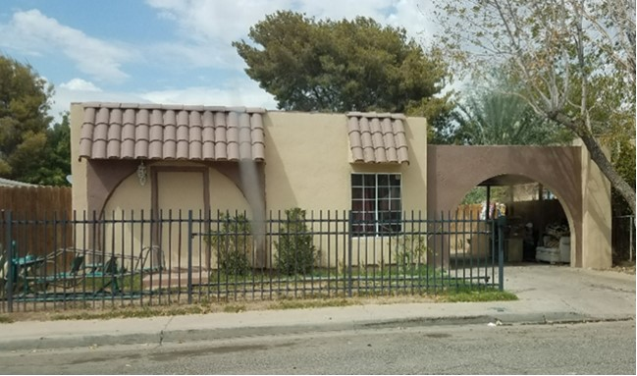
Calexico Location
205 Lopez Court, Calexico, CA

Slide 17
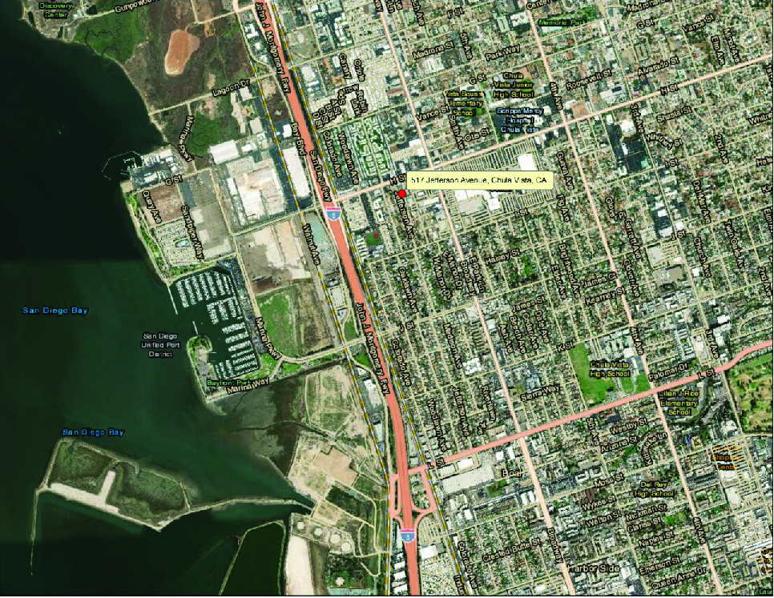
Chula Vista

Slide 18
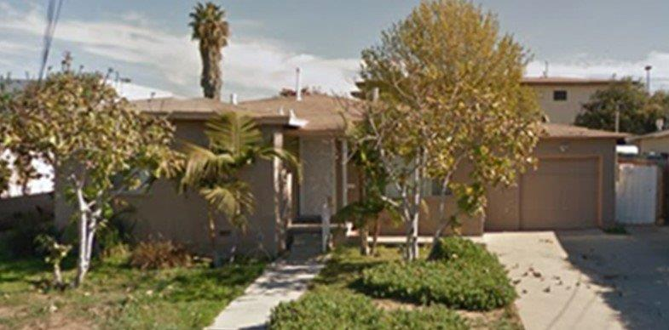
Chula Vista Location
517 Jefferson Avenue, Chula Vista, CA

