Slide 1
San Diego Cross-Border Violence Task Force

Slide 2
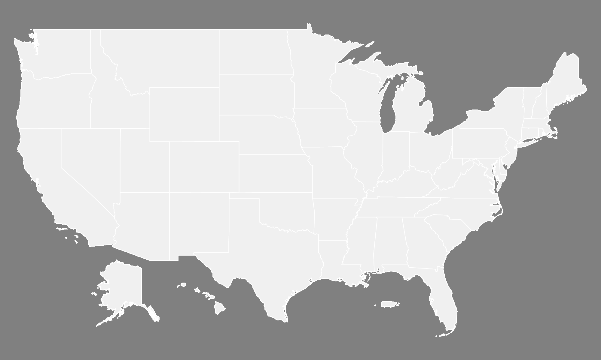
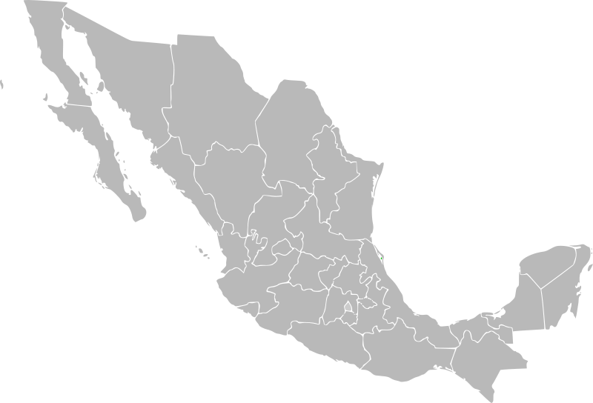
Seizure and Arrest Locations

Slide 3
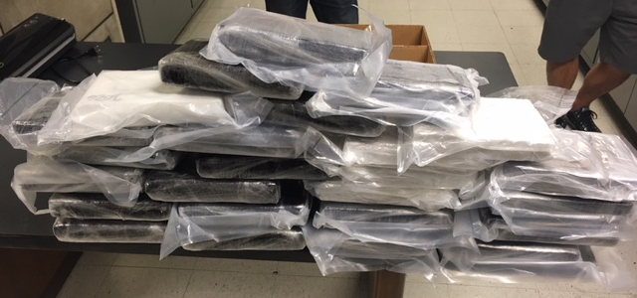
Seizures

Slide 4
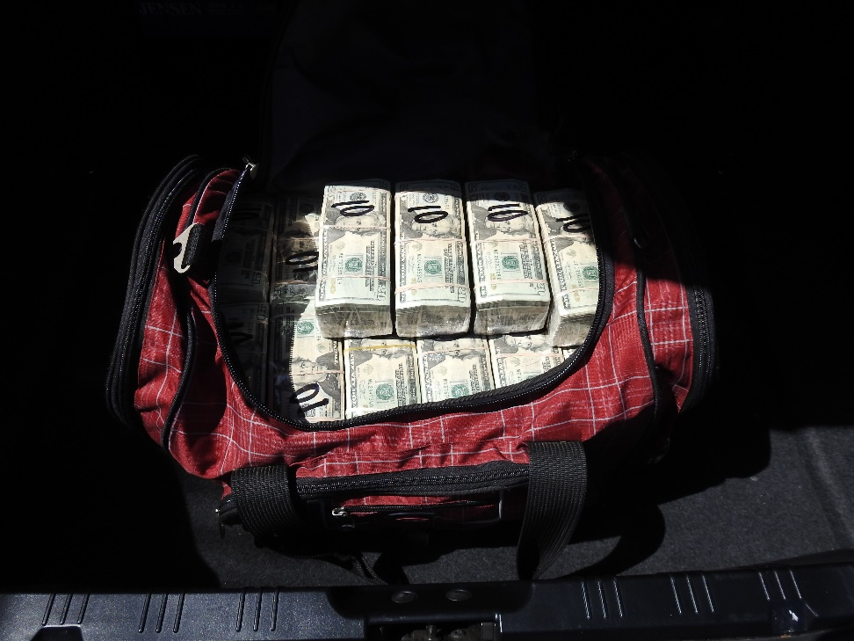
Seizures

Slide 5
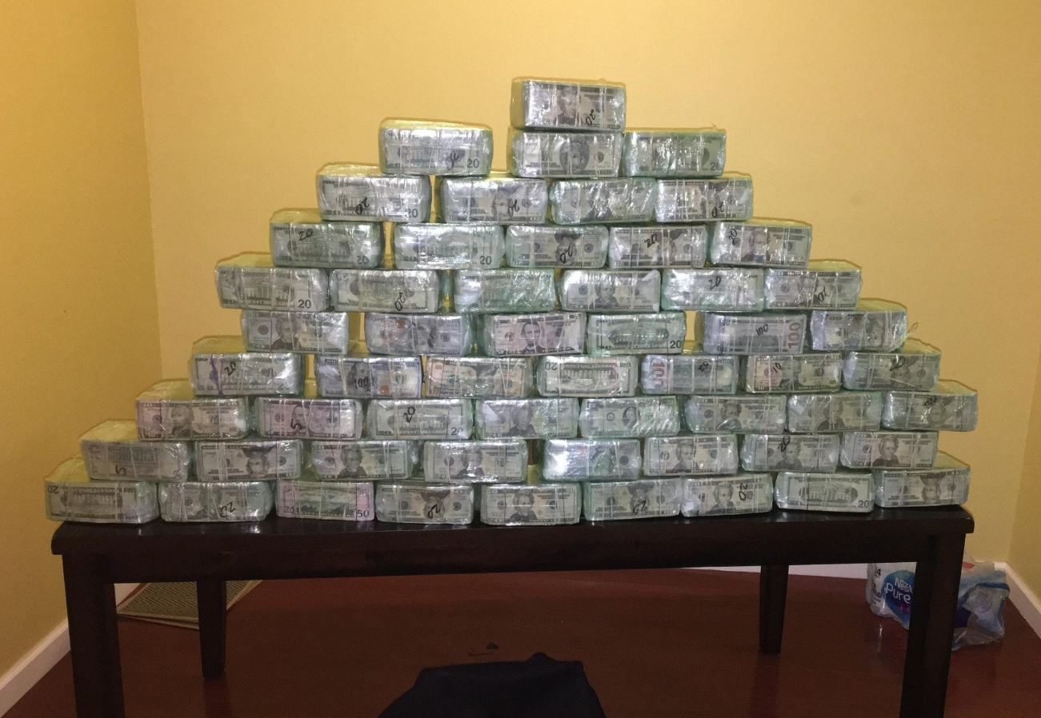
Seizures

Slide 6
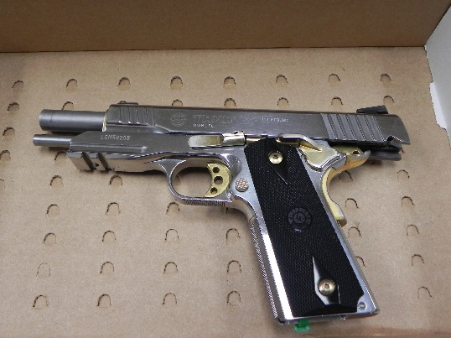
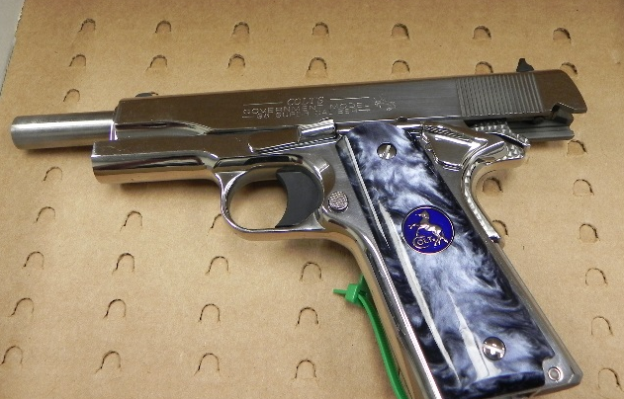
Seizures

Slide 7
San Diego Cross-Border Violence Task Force

